Slide 1





Oracle-enhanced Liquibase SQLcl features
vs standalone Liquibase.
What’s best for you?
Rafał Grzegorczyk
Oracle APEX & PL/SQL Developer
Pretius Low-Code
rgrzegorczyk@pretius.com
Notes:
Welcome

Slide 2

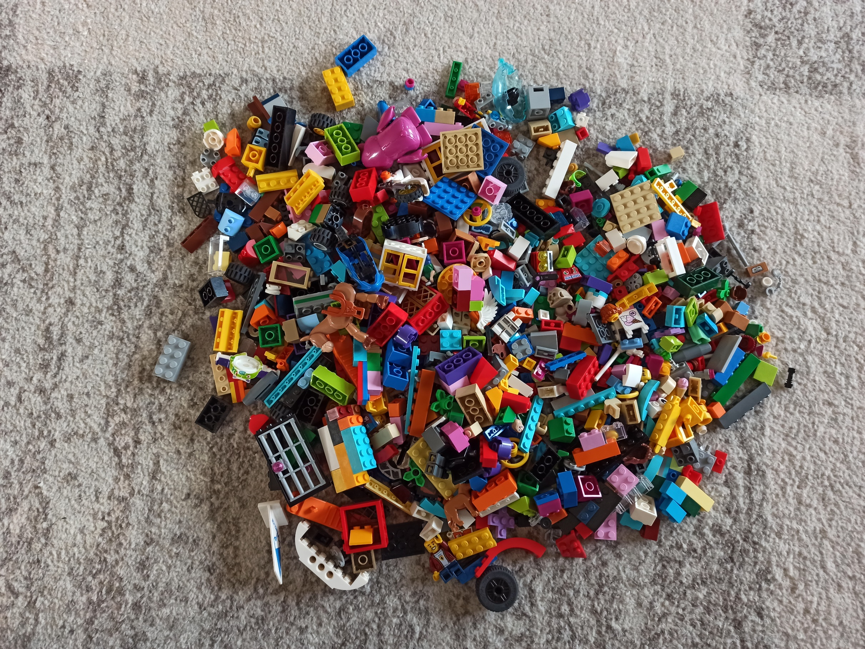
How it all started?
Notes:
How it all started? With a mess.
No database versioning tool, no GIT. 5 developers working on same database.
And one day Project Leader said - Rafal, you must create a script to deploy all new changes on the UAT database.
And I said, OK, but how would I know what I should deploy on UAT.
I know my changes but what about the changes of the other 5 developers?
And he said - that simple, ask them :-)

Slide 3

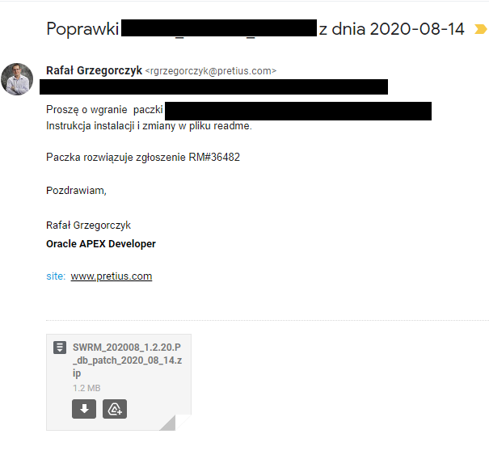
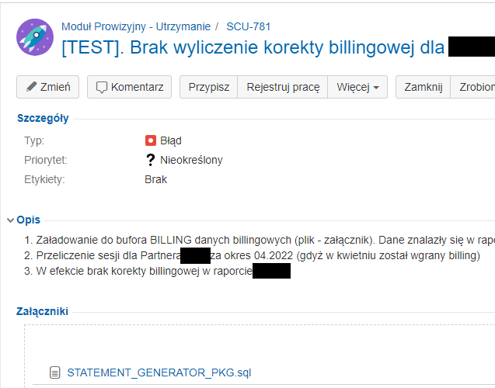






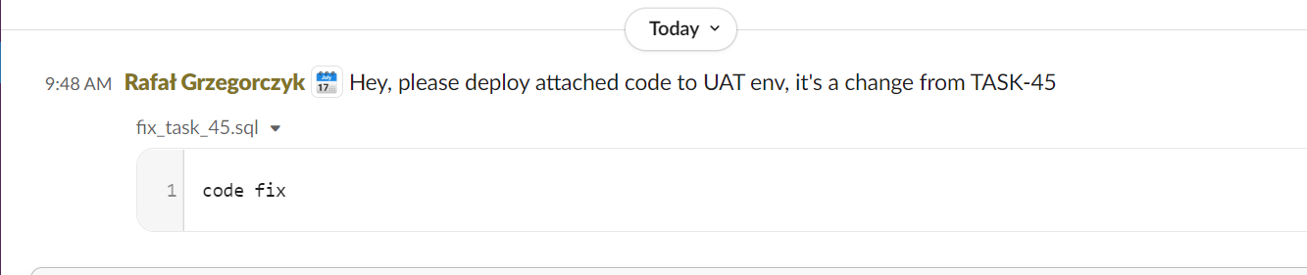

Notes:
And I wasted a lot of time asking them - I received scripts by email, attached to jira tasks and even on the slack communicator.
After gaining all the information, I had to merge those scripts and keep all the code in good execution order.
It took me a lot of time, and It was really painful to do all this.

Slide 4

This was NOT fine
Notes:
It was not OK, so we decided that we needed to find a tool to help organize all this mess and save time.

Slide 5
Let’s throw away this
Notes:
We discovered Liquibase.
And we resigned from this approach.

Slide 6
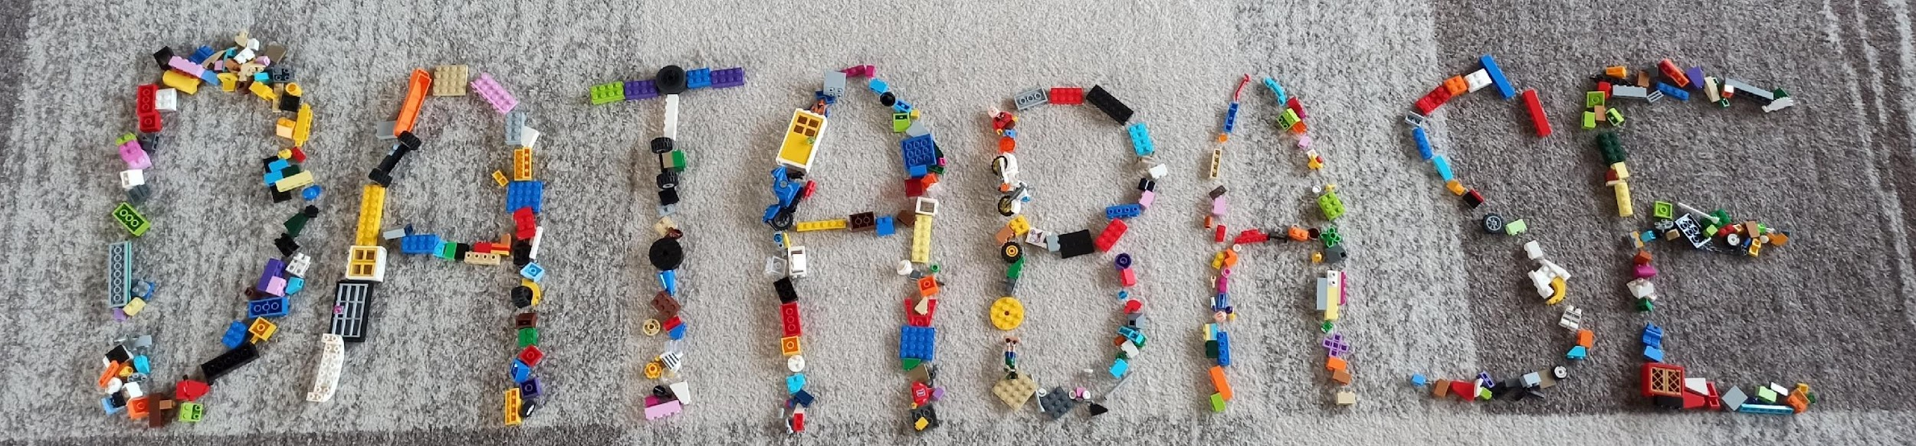

No more mess
Notes:
And replaced with this.
No more mess in deployment scripts.

Slide 7


EXPLAINED
Get this presentation and examples: https://github.com/rgrzegorczyk/sqlcl_vs_core_liquibase
Notes:
I've been using Liquibase standalone open-source version for a few years.
But recently, Oracle incorporated their custom version of LIquibase into the popular SQLcl tool.
So in this presentation, I will compare both editions' options with many examples, solutions and problems.
It will help you to choose the best version for your projects - regardless of your knowledge level.
Or maybe you will choose both of them? :)

Slide 8
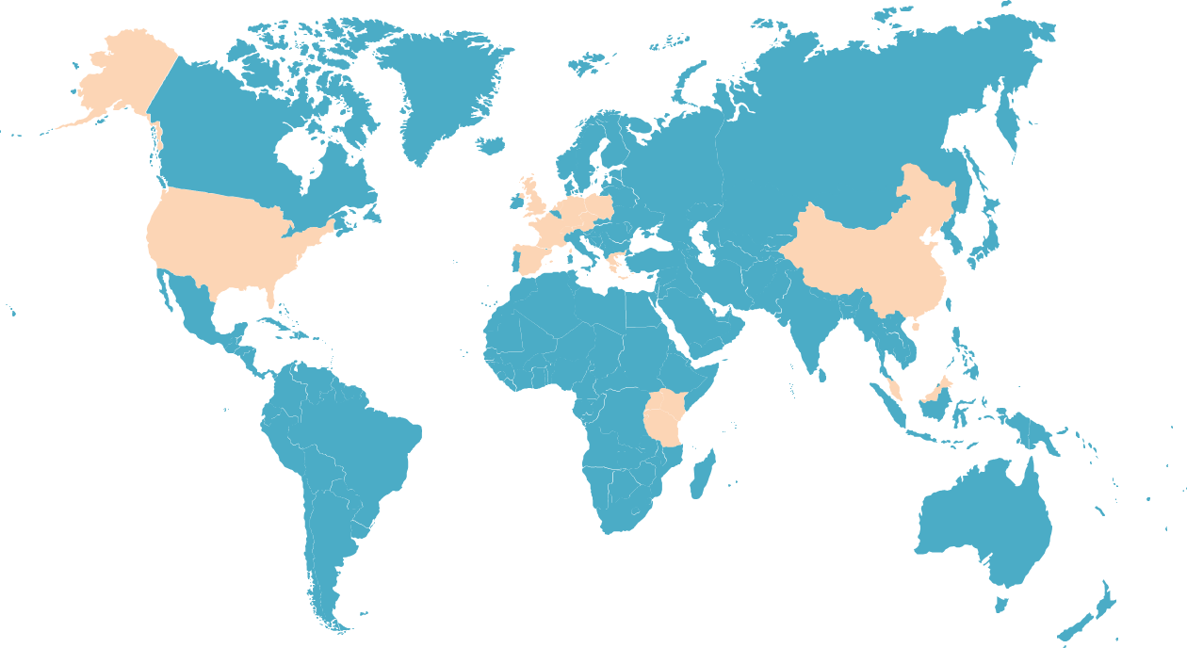


About me
Oracle APEX & PL/SQL Developer at Pretius Low-Code
Over 10 years in IT
Financial systems for government administration
Energy, banking and logistics industry
Database automation fan
Liquibase certified user
Speaker since 2021 ( Kscope, Apex World, DOAG, Switzerland, Croatia, Scotland, Poland)
Blogger at rafal.hashnode.dev and pretius.com/blog/
Rafał Grzegorczyk
Oracle APEX & PL/SQL Developer
rgrzegorczyk@pretius.com r_grzegorczyk
rgrzegorczyk
rafal.hasnode.dev

Slide 9



What is Liquibase?
Open-Source Java based tool
Developed since 2006
Enhanced & implemented into SQLcl in 2019
Command-line based

Slide 10
How liquibase works?

Slide 11

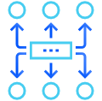


How liquibase works?
Changelog
Changeset
Tracking table
Ledger of changes. It holds information about what and when to execute.
Single DB change identified
by ID, author and file path.
SQL, XML, YAML or JSON
History of changes. Who, when and what. Comments, labels, tags.
Notes:
Changelog
Liquibase uses a changelog to explicitly list database changes in order.
The changelog acts as a ledger of changes and contains a list of changesets (units of change) that Liquibase can execute on a database.
Changeset
Liquibase uses changeset to represent a single change to your database
Each changeset is uniquely identified by ID, author, directory and a filename.
You can have many changesets in one SQL file.
There are 4 different ways to define your changes: SQL, XML, YAML, and JSON formats.
Tracking tables
DATABASECHANGELOG
Liquibase tracks which changeSets have or have not been deployed in a tracking table called a DATABASECHANGELOG.
If your database does not already contain a tracking table, Liquibase will create it for you.

Slide 12
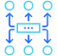
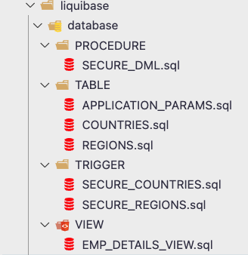
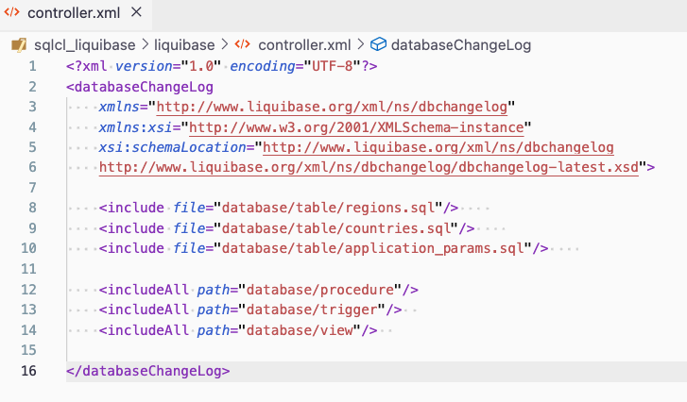
Changelog
Notes:
Changelog
Liquibase uses a changelog to explicitly list database changes in order.
The changelog acts as a ledger of changes and contains a list of changesets (units of change) that Liquibase can execute on a database.

Slide 13
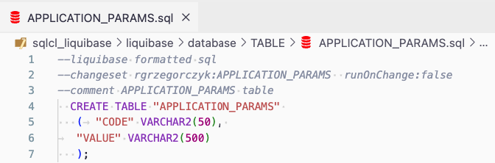
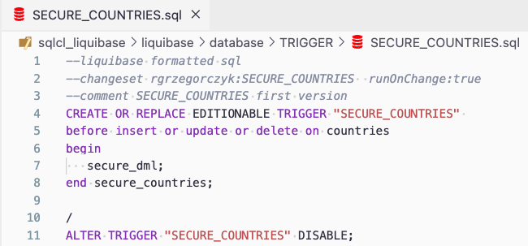
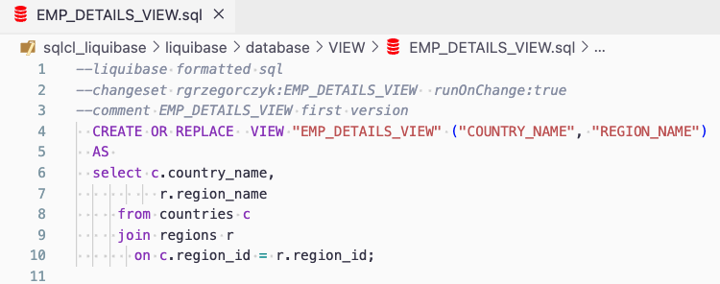
Changesets
Notes:
Changeset
Liquibase uses changeset to represent a single change to your database
Each changeset is uniquely identified by ID, author, directory and a filename.
You can have many changesets in one SQL file.
There are 4 different ways to define your changes: SQL, XML, YAML, and JSON formats.

Slide 14

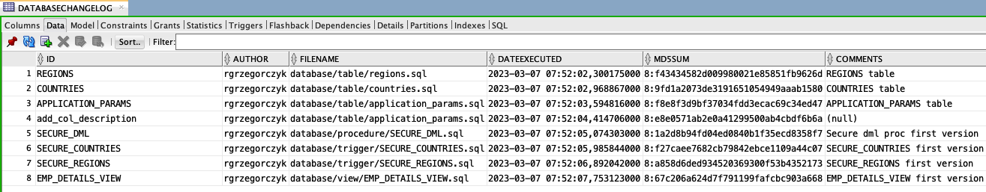
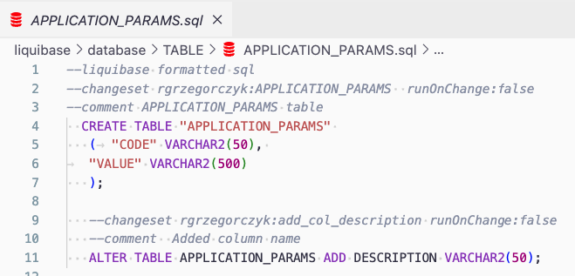
Tracking table
Notes:
Tracking tables
DATABASECHANGELOG
Liquibase tracks which changeSets have or have not been deployed in a tracking table called a DATABASECHANGELOG.
If your database does not already contain a tracking table, Liquibase will create it for you.

Slide 15
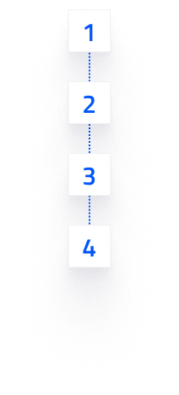
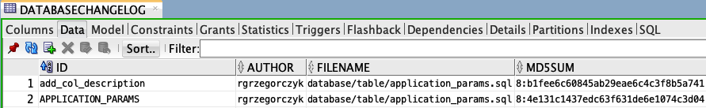
Update command
Deploys any changes in the changelog file that have not been deployed to database yet.
If the unique identifiers do not exist, Liquibase will apply the changeset to the database.
If the unique identifiers exist, the MD5Sum of the changeset is compared to the one in the database.
If they are different, Liquibase will produce an error unless runOnChange is set to true.
Resources: https://docs.liquibase.com/commands/update/update.html
Notes:
The essential Liquibase command we will be using is UPDATE.
How does it work?

Slide 16

Install Run
Liquibase (built-in SQLcl)
Having SQLcl, you already have Liquibase
Recommended minimum version 22.4
Connect to DB as usual
liquibase | lb COMMAND [--OPTIONS]
Notes:
How to install & run both tools
Both tools are command-line based.
If you already have SQLcl, then - you already have Liquibase!
Remember that you need to have standalone SQLcl because Liquibase is not included in SQL Developer installation.
Connection
Using SQLcl connect as usual with a conection string or tnsnames
To run Liquibase:
SQLcl
just type liquibase | lb command -options

Slide 17
Install Run
Liquibase (built-in SQLcl)
Liquibase (standalone)
Having SQLcl, you already have Liquibase
Recommended minimum version 22.4
Connect to DB as usual
liquibase | lb COMMAND --OPTIONS
Download and add to PATH
Use the installer (includes JAVA and the most popular database drivers)
Recommended minimum version 4.19.0
Define “properties” file
liquibase COMMAND --OPTIONS
Resources: https://www.oracle.com/pl/database/sqldeveloper/technologies/sqlcl/download/
https://www.liquibase.com/download
Notes:
How to install & run both tools
If you want to use standalone Liquibase you have 2 options:
download files and manually add liquibase to your system path
or use an installer that includes JAVA and the most popular database drivers
Connection
Using Liquibase - define .properties file for every environment
To run Liquibase:
Liquibase
liquibase command [--options]

Slide 18
Take control over database changes

Slide 19

Challenge
SQLcl enhanced Liquibase vs Liquibase (Standalone)
“Lazy” approach
“Complex” flow
Notes:
OK
It’s time to create a challenge for both tools with some real-world use cases.
Let's see how they deal with them.

Slide 20

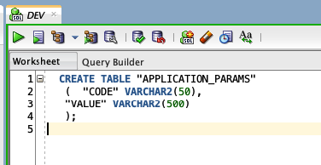
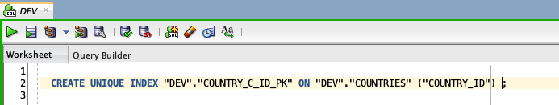
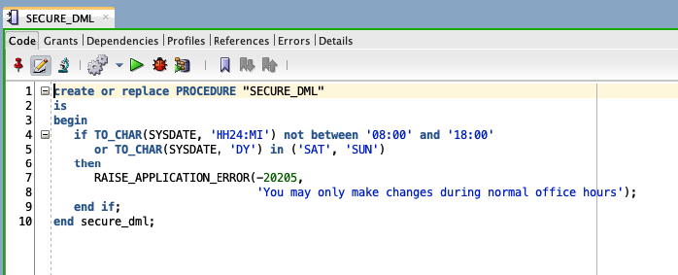
SQLcl Liquibase “lazy” development
1
Making changes directly in DEV schema

Slide 21

SQLcl Liquibase “lazy” development
1
2
Making changes directly in DEV schema
Version 1 finished
Capture schema
> sql /nolog
> conn DEV/********@rgatp28_low
Making changes directly in DEV schema
Resources: Requirements for Using Liquibase

Slide 22
SQLcl Liquibase “lazy” development
1
2
Making changes directly in DEV schema
Version 1 finished
Capture schema
> mkdir v1; cd v1
> conn DEV
> liquibase generate-schema --split
Making changes directly in DEV schema
* You can only capture objects from the schema you are connected to

Slide 23
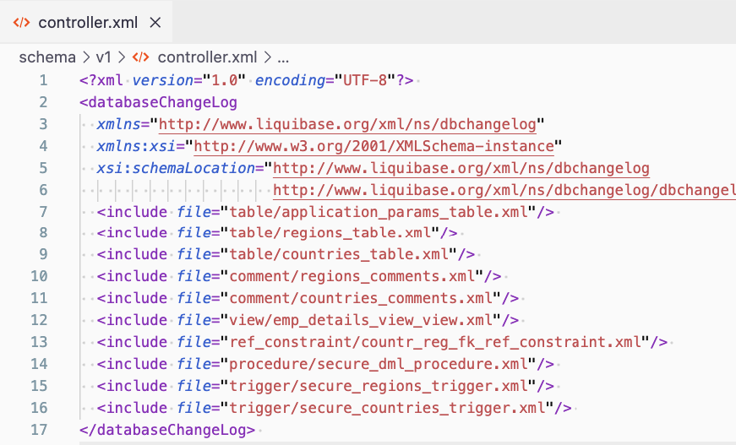
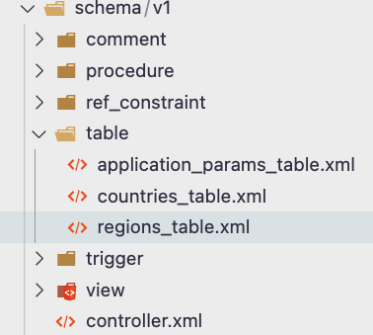
SQLcl Liquibase “lazy” development
1
2
Making changes directly in DEV schema
Version 1 finished
Capture schema
Making changes directly in DEV schema

Slide 24
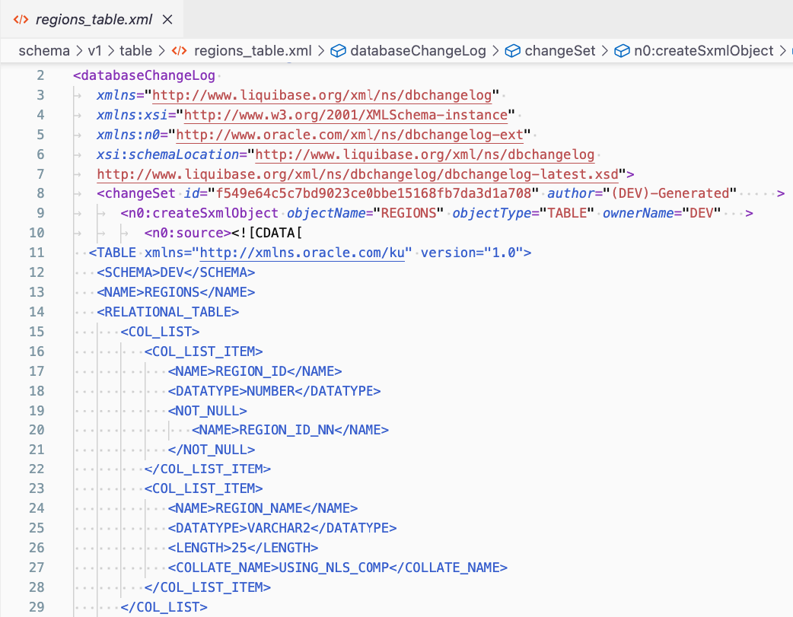
SQLcl Liquibase “lazy” development
1
2
Making changes directly in DEV schema
Version 1 finished
Capture schema
Making changes directly in DEV schema
SXML representation of DDL
uses DBMS_METADATA to transform the state of the database objects dynamically
You don’t even need to open it!

Slide 25
SQLcl Liquibase “lazy” development
1
2
3
Making changes directly in DEV schema
Version 1 finished
Capture schema
Update UAT
> cd v1;conn UAT
> lb update --changelog-file controller.xml
Making changes directly in DEV schema

Slide 26
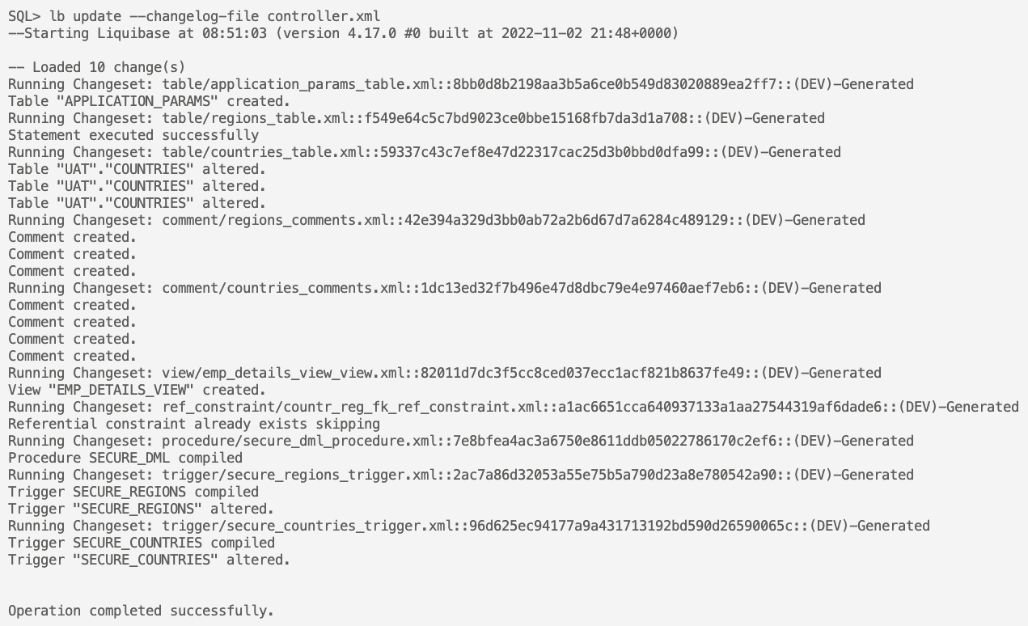
SQLcl Liquibase “lazy” development

Slide 27
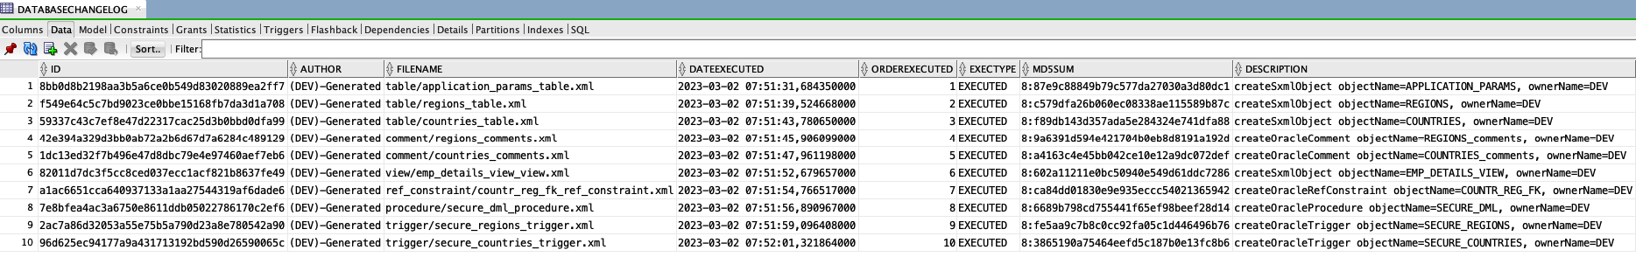
SQLcl Liquibase “lazy” development

Slide 28
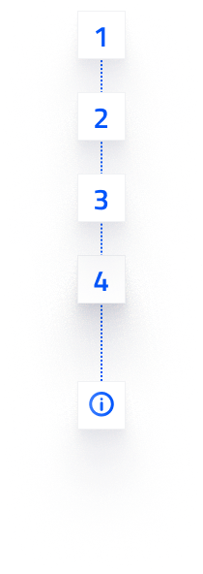
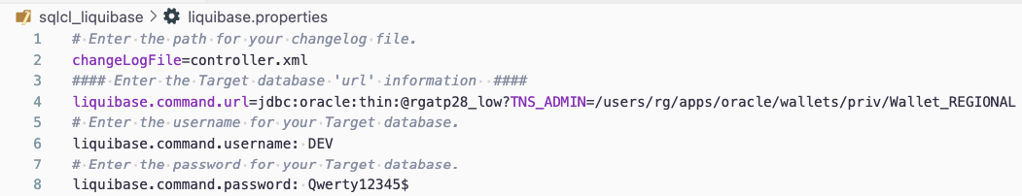
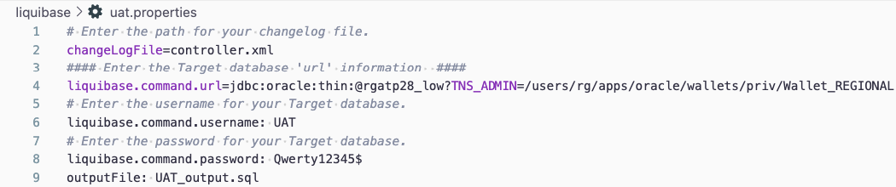
Liquibase (standalone)
Initialize projects (DEV,UAT)
> liquibase init project
“Setup new liquibase.properties (..)?” / Y(Yes)
Resources: https://docs.liquibase.com/concepts/connections/creating-config-properties.html

Slide 29
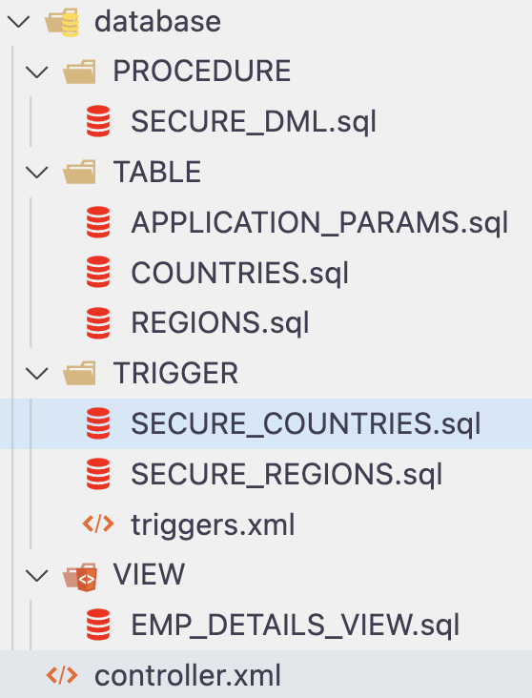
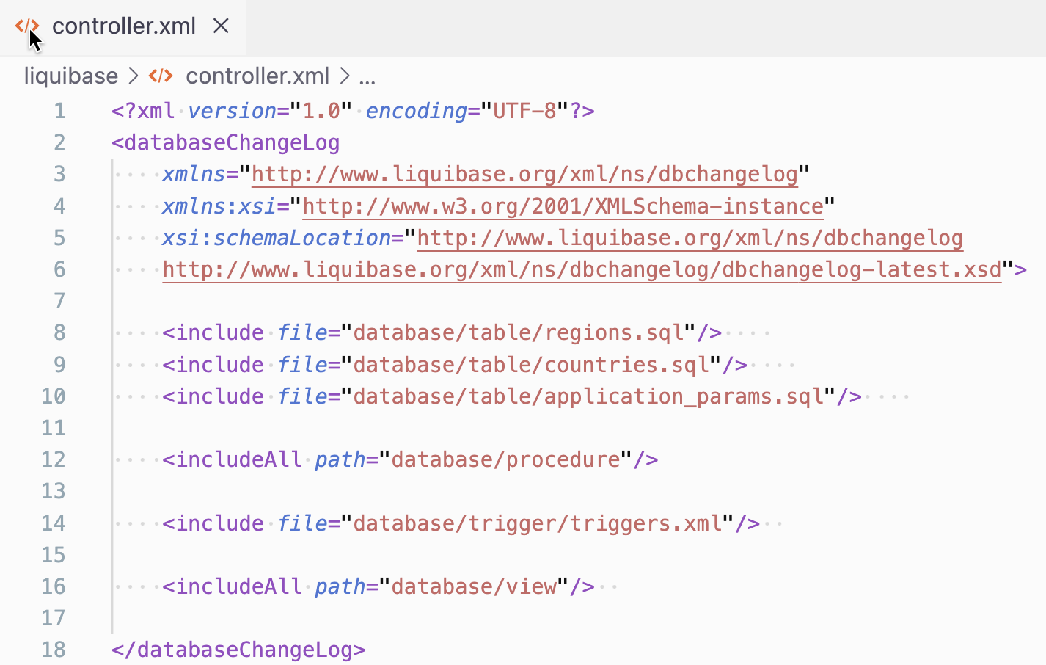
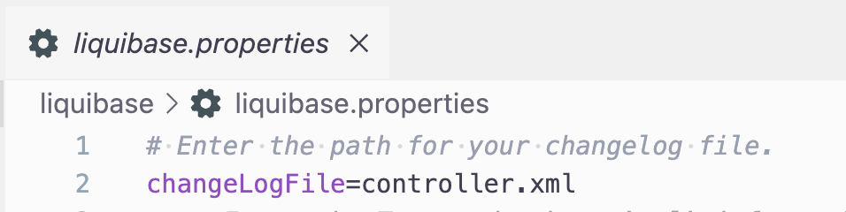
Liquibase (standalone)
Initialize projects (DEV,UAT)
Create changelog(s)
Resources: https://docs.liquibase.com/concepts/changelogs/home.html

Slide 30
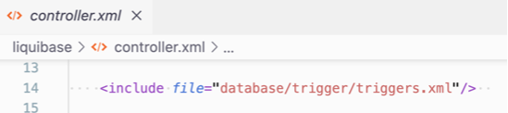
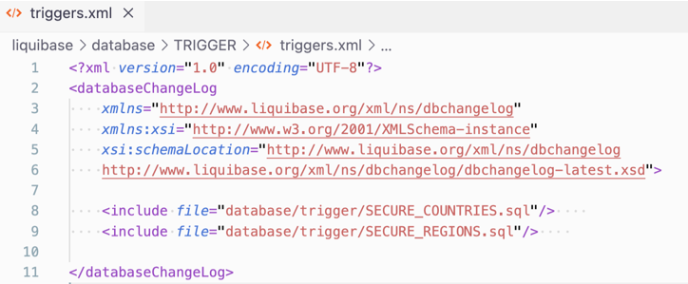
Liquibase (standalone)
Initialize projects (DEV,UAT)
Create changelog(s)
Resources: https://docs.liquibase.com/concepts/changelogs/home.html

Slide 31
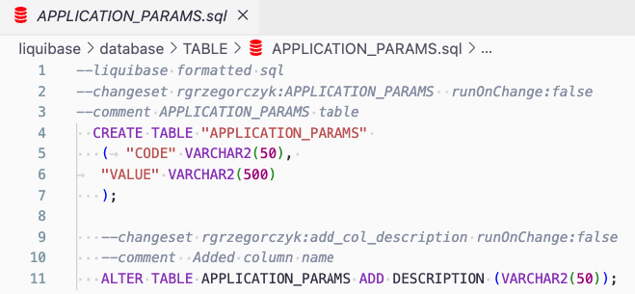
Liquibase (standalone)
Initialize projects (DEV,UAT)
Create changelog(s)
DDL, DML etc. (changesets)
Resources: https://docs.liquibase.com/concepts/changelogs/changeset.html

Slide 32
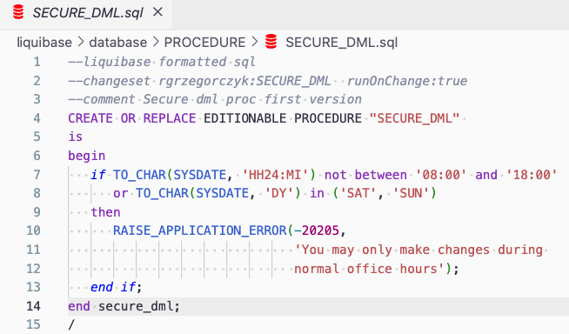
Liquibase (standalone)
Initialize projects (DEV,UAT)
Create changelog(s)
DDL, DML etc. (changesets)
Resources: https://docs.liquibase.com/concepts/changelogs/changeset.html

Slide 33
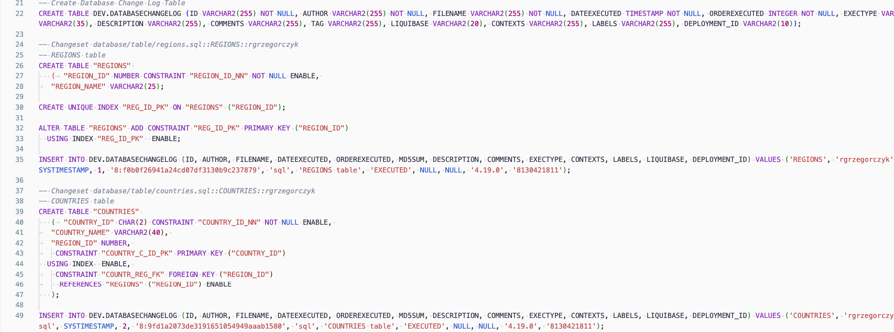
Liquibase (standalone)
Initialize new project
Create changelog(s)
DDL, DML etc. (changesets)
Preview SQL
> liquibase updateSQL

Slide 34
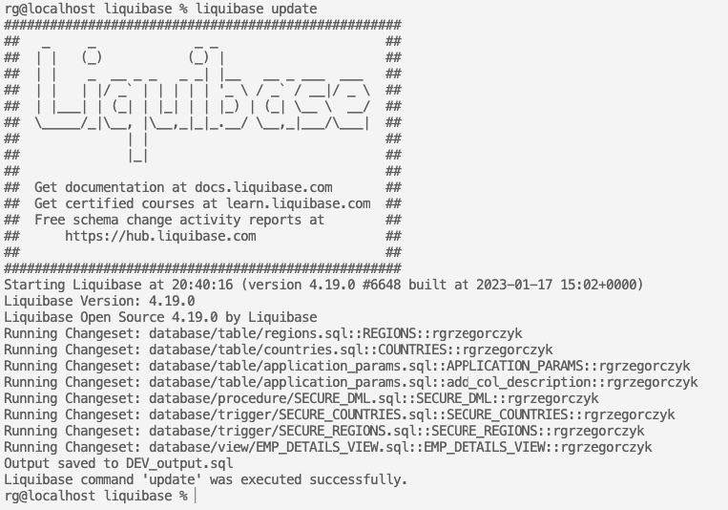
Liquibase (standalone)
Initialize new project
Create changelog(s)
DDL, DML etc. (changesets)
Preview SQL
> liquibase update
Update database (DEV)

Slide 35
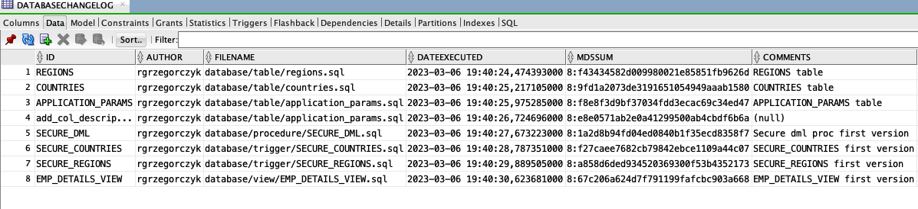
Tracking table preview (DEV)

Slide 36
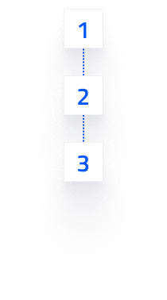

Update UAT
GIT - push, pull, merge etc.

Slide 37
Update UAT
GIT - push, pull, merge etc.
Preview SQL (UAT)
> liquibase --defaults-file=uat.properties updateSQL

Slide 38
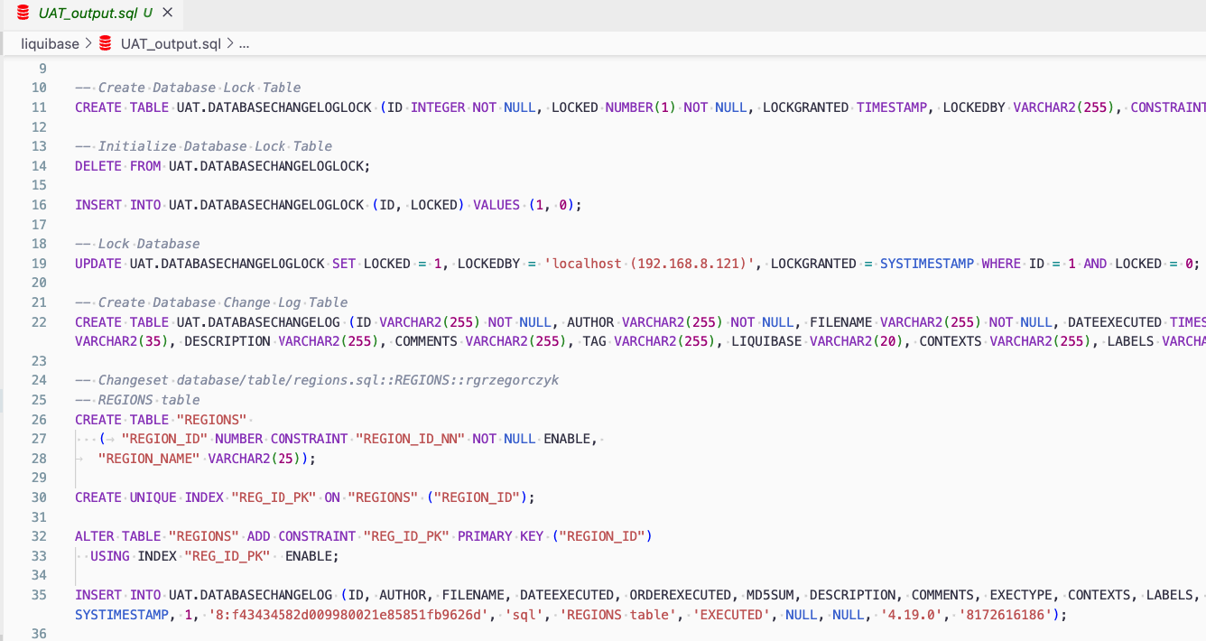
Update UAT
GIT - push, pull, merge etc.
Preview SQL (UAT)

Slide 39
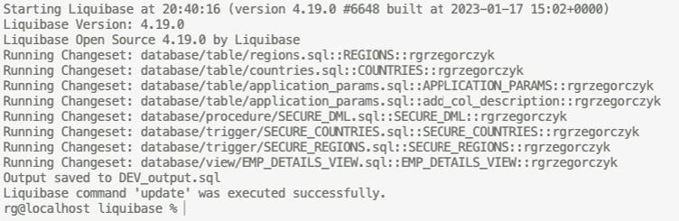
Update UAT
GIT - push, pull, merge etc.
Preview SQL (UAT)
Update database (UAT)
> liquibase --defaults-file=uat.properties update

Slide 40
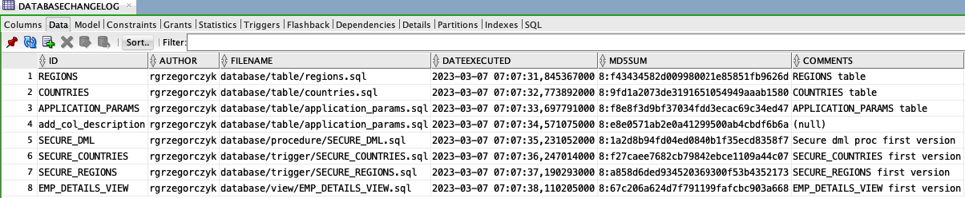
Tracking table preview (UAT)

Slide 41
Lesson learned
SQLcl “lazy” Liquibase
Liquibase (standalone)
you can develop directly at database
no direct database changes
no need to learn liquibase syntax
write changesets (use snippets!) and changelogs using syntax
no individual commits in GIT
fits better for small projects?
better GIT integration, full control on individual changes

Slide 42
Web interface ( deployments preview)
SQLcl Liquibase
Liquibase (standalone)
web preview for Oracle Cloud
no web interface
DATABASECHANGELOG (table)
DATABASECHANGELOG (table)
DATABASECHANGELOG_ACTIONS (table)
DATABASECHANGELOG_DETAILS (view)

Slide 43
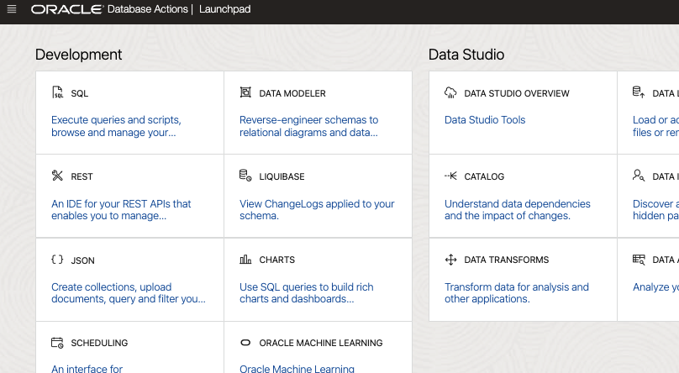
SQLcl Liquibase GUI

Slide 44
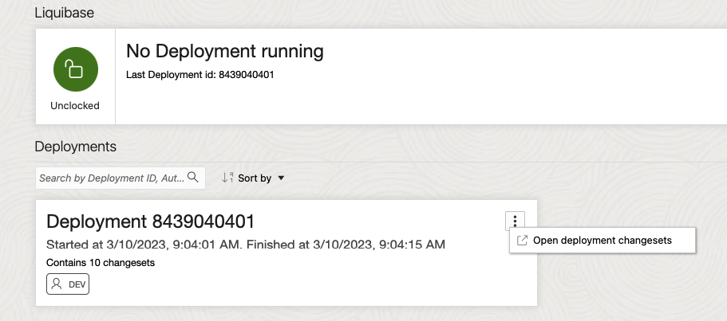
SQLcl Liquibase GUI

Slide 45
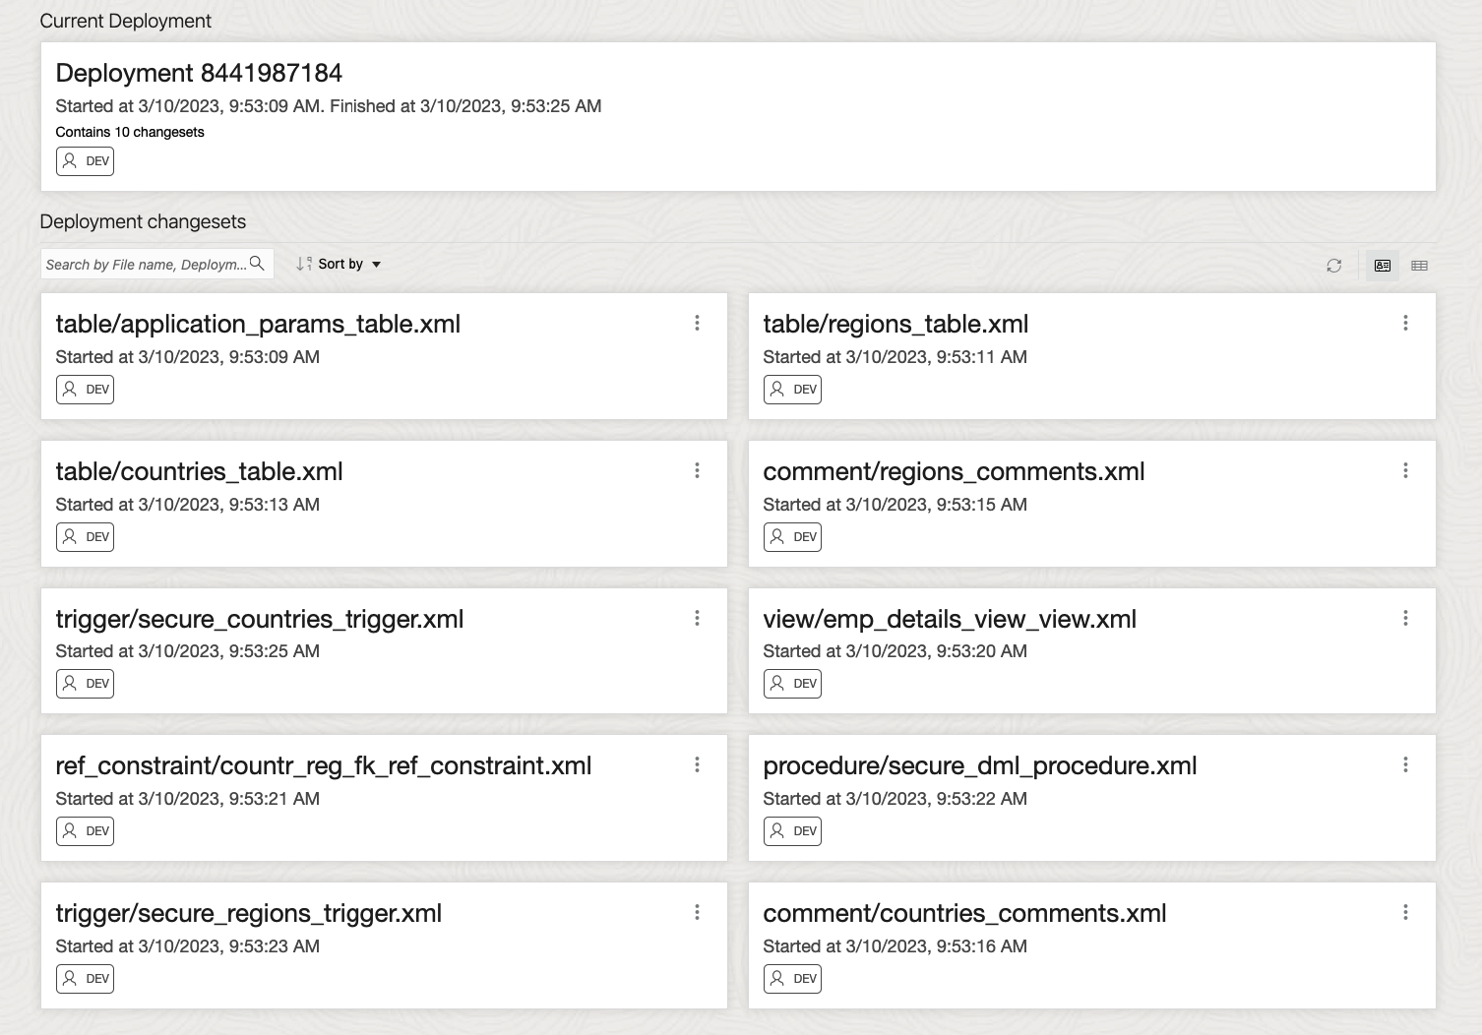
SQLcl Liquibase GUI

Slide 46
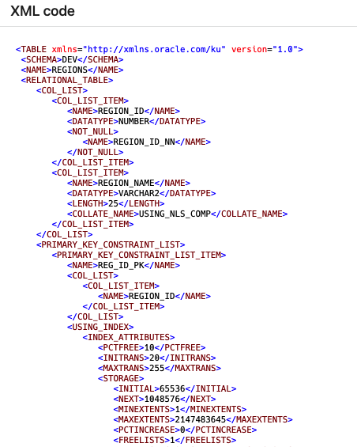
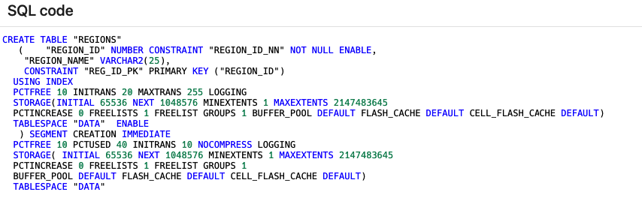
SQLcl Liquibase GUI

Slide 47

Web interface ( deployments preview)
Can you develop your own deployments preview GUI in Oracle APEX in 5 minutes?
Resources: https://www.youtube.com/watch?v=dEV9sc4DnXs

Slide 48

Smart database updates ?

Slide 49
Add new table column

Slide 50
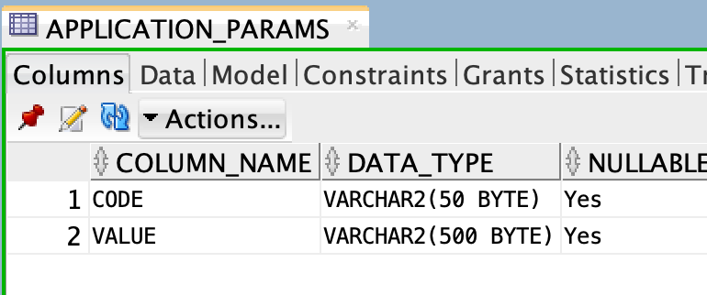
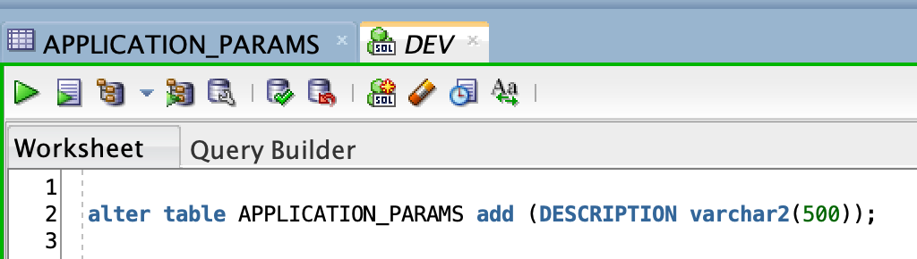
SQLcl Liquibase
Add new column directly on DEV

Slide 51
SQLcl Liquibase
Add new column directly on DEV
Capture DEV schema once again
> mkdir v2; cd v2
> conn DEV
> liquibase generate-schema --split

Slide 52
SQLcl Liquibase
Add new column directly on DEV
capture DEV schema once again
Update UAT
> cd v2
> conn UAT
> liquibase update controller.xml

Slide 53
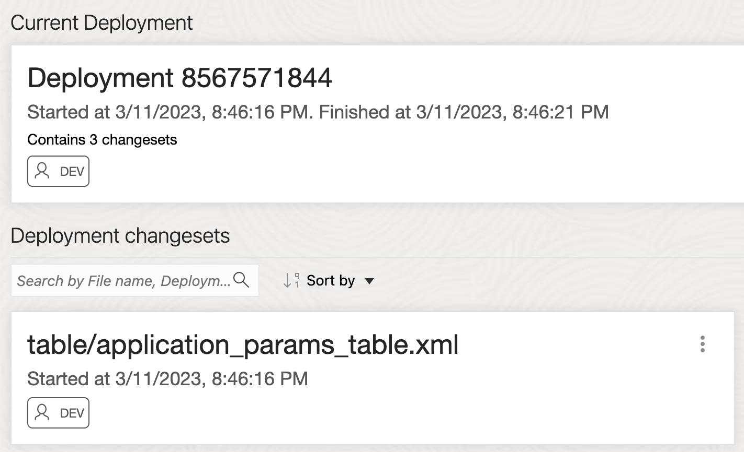

SQLcl Liquibase
Add new column directly on DEV
Capture DEV schema once again
Update UAT
Preview executed code
SQLcl will create your code

Slide 54

Liquibase (standalone)

Slide 55

Liquibase (standalone)
That won’t work

Slide 56

Liquibase (standalone)

Slide 57

Liquibase (standalone)
This won’t work too

Slide 58

Liquibase (standalone)
ORA-00955
Name is already used…

Slide 59

Liquibase (standalone)
It will work :)

Slide 60
Add column that already exists?

Slide 61


Add column that already exists?
* Using standalone Liquibase you mustn’t do any DB changes directly!

Slide 62
Liquibase (standalone)

Slide 63

Liquibase (standalone)
ORA-01430
Column being added already exists

Slide 64


Really smart SQLcl Liquibase

Slide 65
Modify not empty column
(not so smart Liquibase - both versions)

Slide 66


SQLcl Liquibase
Alter table at DEV

Slide 67
SQLcl Liquibase
Alter table at DEV
Capture DEV schema
> conn DEV
> liquibase generate-schema --split

Slide 68

SQLcl Liquibase
Alter table at DEV
Capture DEV schema
Update UAT (preview)
> conn UAT
> liquibase updateSQL –changelog-file controller.xml

Slide 69
SQLcl Liquibase
Alter table at DEV
Capture DEV schema
Update UAT (preview)
Update UAT
> conn UAT
> liquibase update –changelog-file controller.xml

Slide 70

SQLcl Liquibase
Alter table at DEV
Capture DEV schema
Update UAT (preview)
Update UAT
Oooops…

Slide 71

Liquibase (standalone)
> liquibase update

Slide 72

Liquibase (standalone)
ORA-01439
Column must be empty

Slide 73

Liquibase (standalone)
Create extra changeset

Slide 74
Liquibase (standalone)
Create extra changeset
Add preConditions

Slide 75
Liquibase (standalone)
Create extra changeset
Add preConditions
Run changeset if condition is met

Slide 76

Liquibase (standalone)
Create extra changeset
Add preConditions
Run changeset if condition is met

Slide 77

Liquibase (standalone)
Create extra changeset
Add preConditions
Run changeset if condition is met
Preview SQL by updateSQL

Slide 78

Liquibase (standalone)
Create extra changeset
Add preConditions
Run changeset if condition is met
Preview SQL by updateSQL
Update database

Slide 79

Rollbacks

Slide 80
SQLcl Liquibase
SQLcl knows exact code that was executed
(DATABASECHANGELOG_ACTIONS table)
Rollback script is created automatically

Slide 81
SQLcl Liquibase
rollback (to specific tag)
rollback-to-date
rollback-count

Slide 82
SQLcl Liquibase
--preview rollback script, not execute
> conn UAT
> lb rollback-count –changelog-file controller.xml –count 999 –output-file test.sql

Slide 83

SQLcl Liquibase

Slide 84
SQLcl Liquibase
--execute rollback
> conn UAT
> lb rollback-count –changelog-file controller.xml –count 999

Slide 85

SQLcl Liquibase

Slide 86

Liquibase (standalone)
Developers write rollbacks
More control
Rollbacks can be automated with XML changesets (but who wants to write it instead of SQL?)
Liquibase rollbacks: https://pretius.com/blog/liquibase-rollback-jenkins-oracle-apex/

Slide 87
Integration

Slide 88
SQLcl “lazy” Liquibase vs GIT
Development - phase 1

Slide 89


SQLcl “lazy” Liquibase vs GIT
Development - phase 1
v1 > lb generate-schema --split --sql

Slide 90

SQLcl “lazy” Liquibase vs GIT
Development - phase 1
v1 > lb generate-schema --split --sql
Initial commit

Slide 91

SQLcl “lazy” Liquibase vs GIT
Development - phase 1
v1 > lb generate-schema --split --sql
Commit changes
Development - phase 2
Remove files inside /v1/
v1 > lb generate-schema --split --sql
Commit changes

Slide 92

SQLcl “lazy” Liquibase vs GIT
Development - phase 1
v1 > lb generate-schema --split --sql
Commit changes
Development - phase 2
Remove files inside /v1/
v1 > lb generate-schema --split --sql
Commit changes

Slide 93


SQLcl “lazy” Liquibase vs GIT
Development - phase 1
v1 > lb generate-schema --split --sql
Commit changes
Development - phase 2
Remove files inside /v1/
v1 > lb generate-schema --split --sql
Commit changes
Deploy

Slide 94

SQLcl “lazy” Liquibase vs GIT

Slide 95

Liquibase (standalone) vs GIT
ID, filename, author

Slide 96

Liquibase (standalone) vs GIT
ID, filename, author
All details in GIT

Slide 97


Liquibase (standalone) vs GIT
ID, filename, author
All details in GIT
Additional info ( version, task number)

Slide 98
Liquibase (standalone) vs GIT
ID, filename, author
All details in GIT
Additional info ( version, task number)
Selected deployment by:
specific branch
liquibase contexts, labels or tags
> liquibase update --contexts=v2 --labels=jira-4
Liquibase advanced features: https://pretius.com/blog/liquibase-database-version-control/
Liquibase contexts and labels: https://www.liquibase.com/blog/contexts-vs-labels

Slide 99
SQLcl exclusive commands

Slide 100
Oracle APEX export
SQLcl> liquibase generate-apex-object -applicationid 200

Slide 101

Oracle APEX export

Slide 102
Oracle APEX deploy
SQLcl> connect UAT
SQLcl> liquibase update -changelog-file f200.xml
APEX scripts are not supported in Open Source Liquibase (standalone) *
* Liquibase PRO license required

Slide 103

SQLcl Liquibase + APEX one-click deployment
“Deconstructing the APEX Application Development Lifecycle Paper” by Matt Mulvaney
APEX World 30.03.2023 14:45
If you missed it:
Kscope23, 25 - 29.06.2023, Aurora (USA)

Slide 104

Generate object
SQLcl> lb generate-object -object-type table -object-name regions

Slide 105

Notes:
You can modify generated changeset.

Slide 106

Notes:
Add path to other SQL changelog and execute some code before running changeset with REGIONS table

Slide 107


Notes:
Or add another changeset

Slide 108

All SQLcl exclusive commands
generate-ords-schema
generate-control-file
generate-ords-module
generate-object
generate-apex-object
generate-schema
Resources: https://docs.oracle.com/en/database/oracle/sql-developer-command-line/22.4/index.html

Slide 109
Summary
SQLcl “lazy” Liquibase
Liquibase (standalone)
transforms state of the database objects dynamically
need to learn syntax ( use snippets!)
full control over individual changes
automatic object updates
selected deployment (contexts, labels, tags)
automated rollbacks
rollbacks needs to be written
web reporting (OCI only)
no APEX support in open source version
APEX, ORDS support
not all objects / data types supported (e.g BFILE or JSON)
all objects and data types included
better for small projects
fits better to advanced projects

Slide 110
Challenge
is now…..
SQLcl enhanced Liquibase
vs
Liquibase (standalone)

Slide 111

Cooperation
SQLcl enhanced Liquibase
Liquibase (standalone)

Slide 112
SQLcl Liquibase + Liquibase(standalone)
add .jar files from SQLcl to liquibase/lib
use Liquibase (standalone) with full support of SQLcl generated changesets ( schema, APEX, ORDS etc.)
combine files created with generate-schema command with advanced logic from manually created changesets
Read more: https://docs.oracle.com/en/database/oracle/sql-developer-command-line/22.4/index.html

Slide 113
What do you choose?
SQLcl enhanced Liquibase
Liquibase (standalone)

Slide 114
Questions & Answers

Slide 115
Presentation and examples: https://github.com/rgrzegorczyk/sqlcl_vs_core_liquibase
Want more? Pretius resources:
Liquibase tutorial: https://pretius.com/blog/liquibase-tutorial/
Liquibase rollbacks: https://pretius.com/blog/liquibase-rollback-jenkins-oracle-apex/
Flyway, Gradle & APEX https://pretius.com/gradle-flyway-oracle-apex-a-few-words-about-migration-part-1/
Other resources:
Liquibase standalone documentation: https://docs.liquibase.com/home.html
SQLcl Liquibase documentation : https://docs.oracle.com/en/database/oracle/sql-developer-command-line/22.4/index.html
SQLcl Liquibase features explained by Oracle : https://speakerdeck.com/thatjeffsmith/oracle-change-management-with-sqlcl-and-liquibase
Rafał Grzegorczyk
Oracle APEX & PL/SQL Developer
rgrzegorczyk@pretius.com r_grzegorczyk
rgrzegorczyk
rafal.hasnode.dev

Slide 116
Thank you

